Slide 1

Week 7: SwiftUI Fundamentals
In the AI Era(Swift + SwiftUI)
Instructor : Mr. Nem Sothea
nemsothea13@gmail.com

Slide 2

📋 Declarative vs. Imperative UI
Imperative UI (UIKit): You tell the system how to achieve the result
  Manual view hierarchy management
  State changes require explicit updates
  More control but more boilerplate code
Declarative UI (SwiftUI): You tell the system what you want
  Automatic view hierarchy updates
  State-driven UI updates
  Less code, more maintainable
Why SwiftUI Exists:
  Modern Apple platform development
  Reactive programming paradigm
  Live previews and hot reloading
  Cross-platform (iOS, macOS, watchOS, tvOS)
  Built with Swift from the ground up

Slide 3
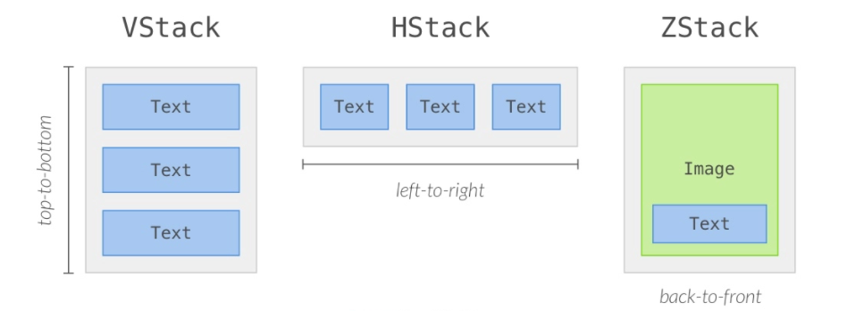
📋 SwiftUI — HStack VStack and ZStack
1- VStack, a vertical stack, which shows views in a top-to-bottom list
2- HStack, a horizontal stack, which shows views in a left-to-right list
3- ZStack, a depth-based stack, which shows views in a back-to-front list

Slide 4
Questions?
Next Week: Hello, SwiftUI! The Paradigm Shift~
Thank you!

